Slide 1
Markdown How-To
Light-weight web text language with essential/minimal formatting
Commonly used for documentation
Portable/platform independent
Markdown Cheat Sheet
Markdown Crash Course (YouTube)
The Markdown Guide – Getting Started
Word to Markdown Converter
Google Docs to Markdown

Slide 2
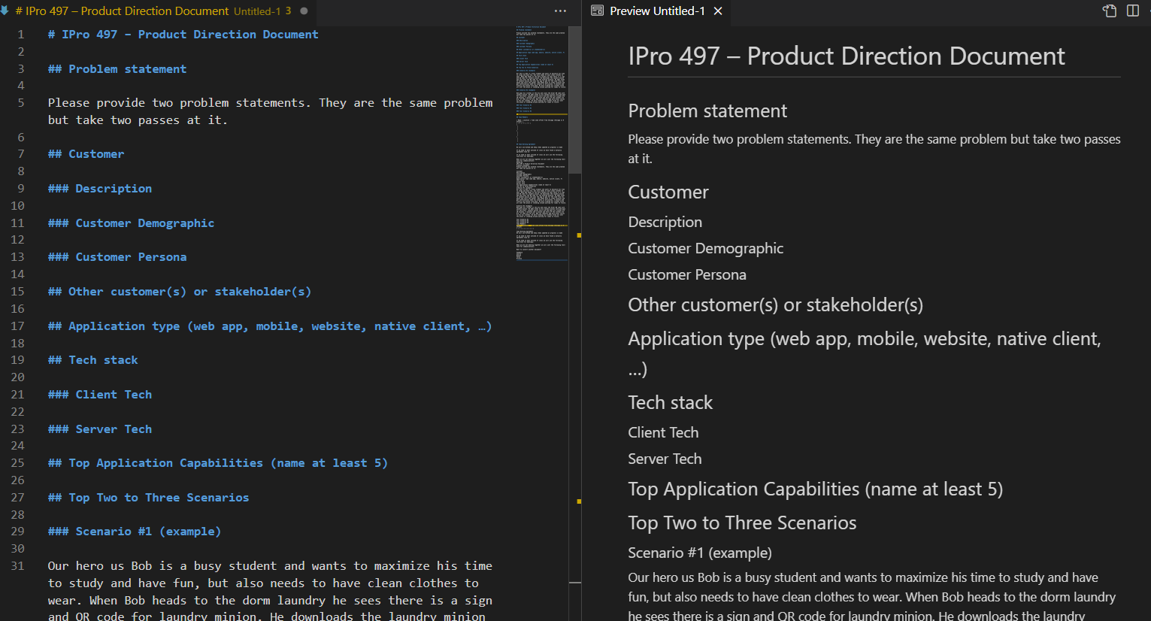

Slide 3
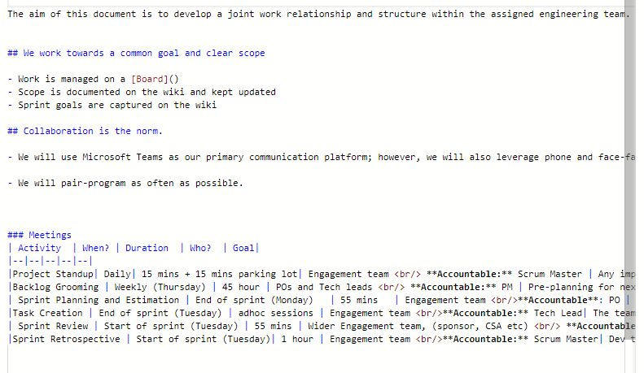

Slide 4
